Slide 1
Airbnb User Insights
Provide Insights on American Airbnb Users and recommend Business Strategies

Slide 2
The problem
Airbnb
Goals
Dataset
Airbnb, Inc. is an online marketplace for short- and long-term homestays and experiences. The company acts as a broker and charges a commission from each booking.
Get to know the american Airbnb user demographic.
Provide better recommendations to users.
Allocate resources towards marketing and development.
Usage data of american Airbnb users from the year 2010 to 2014.
Data Source: Kaggle

Slide 3
Contents
Statistical Tools
Data Visualization
Analysis & Insights
Business Recommendations

Slide 4
Statistical Tools
Chi squared test over skewed distribution was used for testing Null Hypothesis and to gain more insight into the dependance of features on one another. The significance level of 0.05 was chosen for the tests. Some results obtained were:
Gender of a person influences the country they are most likely to visit. These two quantities were observed to be dependent on each other.
The method of signup has no relation to the device used. These two were independent of each other.

Slide 5
Data Visualization, Analysis and Inference

Slide 6
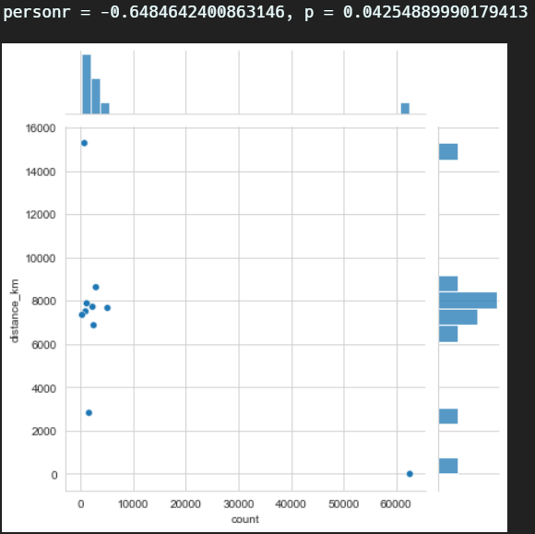
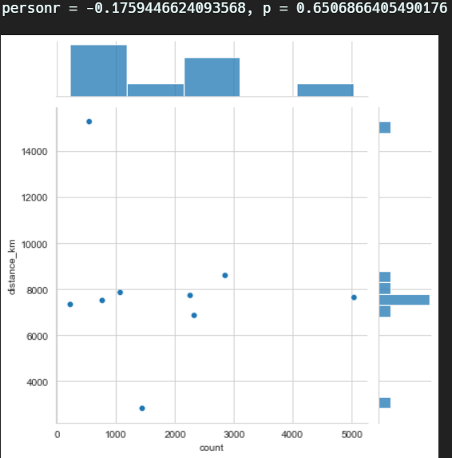
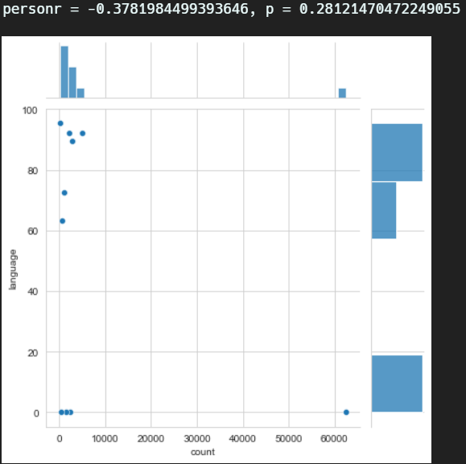
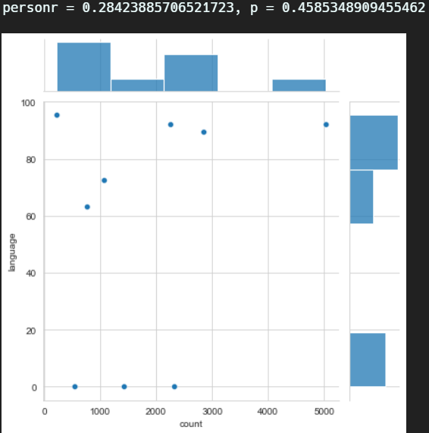
Country
with the United States
without the United States
Notes:
Since the bookings count data is heavily skewed with United States Destinations, hence I decided to try removing US to gain inferences over other travel destinations relatively.
Pearsons test for calculating correlations between features.

Slide 7
Country Insights
The countries that are represented in this dataset largely consist of an aging population. The largest groups are people with mean ages 47 years and 52 years.
One very interesting thing to note is that the sex ratio is skewed towards men for younger age groups but as the mean age increases, the ratio skews more towards women. Women indeed live longer than men.
There is a negative correlation between country preference and country distance.
The correlation is more complicated for language levenshtein distance (Negative including US but positive excluding it).

Slide 8
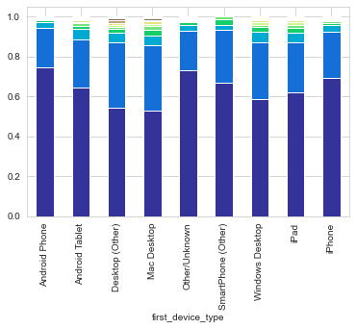
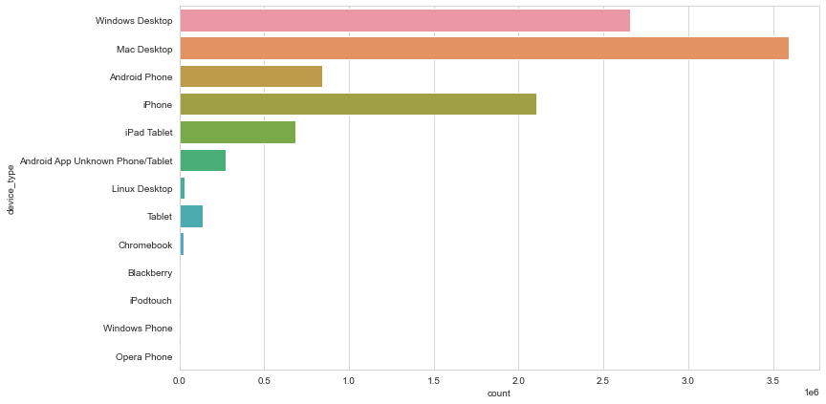
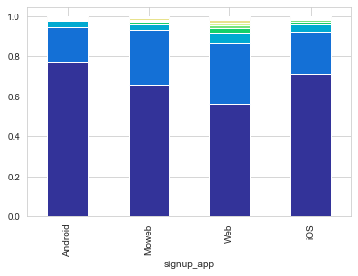
Device Session

Slide 9
Device Insights
It can be seen that Apple devices are the preferred choice for most of the users.
This might suggest that there could be a user experience issue in the android version of the app.
Users using the Web App are most likely to book an Airbnb whereas Android Users are least likely to do so.
People with an Android Phone or whose devices were unknown bought fewer Airbnbs. People on Desktops (Mac or otherwise) bought more.
This strongly suggests that users on their desktop will be more likely to book an Airbnb and Apple Users are more prone to buying on the website whereas Android Users are the least.

Slide 10
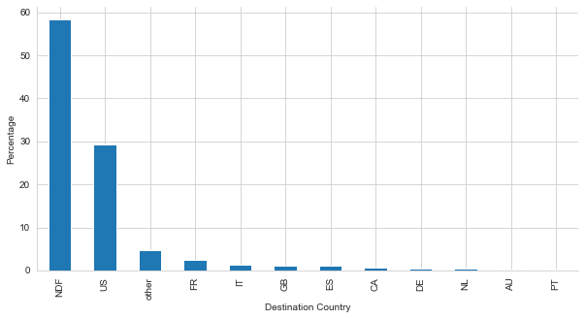
Destinations
Insights
The United States constitute of almost 30% of the bookings. Which means that majority of the Airbnb users are generally searching for endemic accommodations.
NDF implies that no booking was done. Hence, we observed that about 55-60% of users have never booked an Airbnb

Slide 11
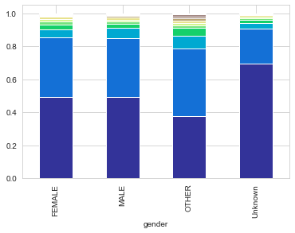
Gender
Insights
People who haven't marked their gender are less likely to book an Airbnb.
People who have marked themselves as 'other' are more likely than any other group to make a booking. Although the population of ‘other’ users is insignificant.
There are more identified female users than male users.

Slide 12
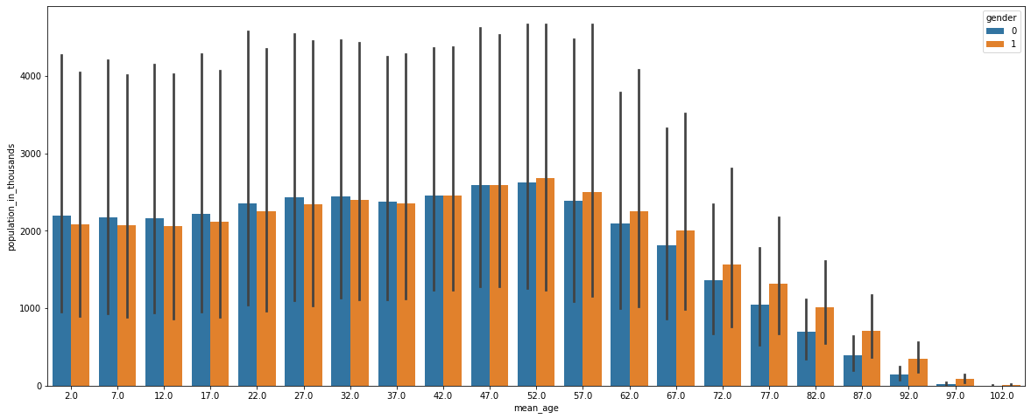
Age

Slide 13
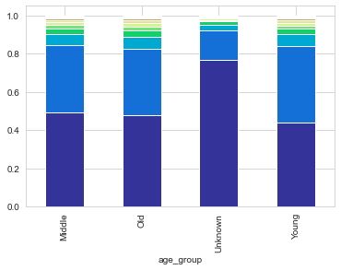
Insights
Great Britain has the highest average age of travellers.
Spain is more popular amongst younger travellers.
People who have not disclosed their ages are least likely to book an Airbnb.
Out of the users whose age we know, Middle Aged People are most likely to book an Airbnb although it must be noted that there isn't a very significant difference amongst the three groups.

Slide 14
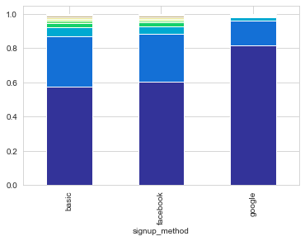
Signup Method
Insights
Basic and Facebook are the most popular methods of Signup.
People who use the Basic Method are the most likely to book an Airbnb.
People signing up using Google are least likely to book an Airbnb.

Slide 15
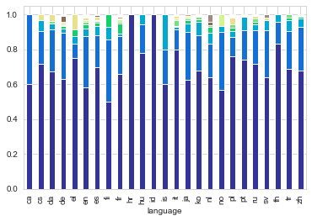
Languages

Slide 16
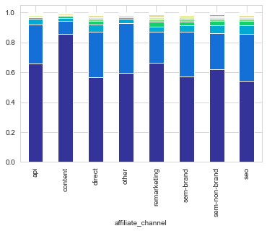
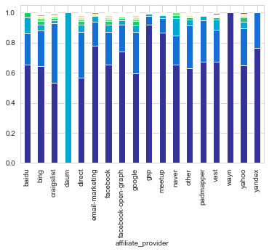
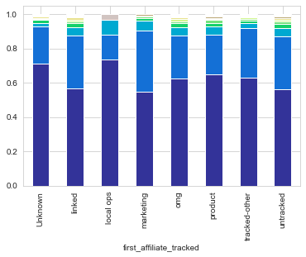
Affiliate Channels

Slide 17
Affiliate Channel Insights
The Direct Channel has the most number of conversions to bookings whereas the Content Channel has the least.
Direct and Google are the most popular affiliate providers.
Wayn has the least percentage of conversions whereas Daum has the most.
Apart from the above, Google and Craigslist have a good percentage of conversions.
People with Marketing affiliates were most likely to book. People whose first affiliate was tracked as Local Ops or was Unknown were least likely.

Slide 18
Business Strategies

Slide 19
Device Specific Strategies
The majority of Airbnb's users are on Apple Devices. Additionally, Android users are the minority and don't book that often. It makes perfect business sense to invest more resources in improving the user experience of iOS apps. On the other hand, Airbnb could also investigate into the smaller conversion rate of Android Users and try to deduce some correlation with certain quirks of the Android Airbnb App.
Desktop Users book far more often than other device users. This could mean that people generally use smaller devices for surfing and exploration and desktops to make the actual booking. The User Experience for the apps on different devices must be tuned accordingly to achieve best results. The team could also look into making the booking process seamless of mobile devices in some way so as to increase mobile conversions.

Slide 20
In-App Recommendations
Most of the Airbnb Users tend to book an Airbnb within the country. Therefore, it makes most sense to give the users more recommendations that are endemic to the country. American users should get more Experience and Host recommendations within the USA. This is not the case with the current Airbnb site where most recommendations are that of exotic locations in faraway places.
People who haven't filled out their information such as Age and Gender are the least likely to book Airbnbs. This is likely due to the fact that they are only in the exploration stage. Maximum marketing effort must be aimed at these people and the most enticing yet affordable offers must be made to them to increase their rate of conversion.

Slide 21
Marketing Strategies
Most of the Airbnb user books are seen to be made from the middle and younger age group of people, hence the marketing efforts should be made in these directions. Demo target user profiles should be created to easily convert individuals through ads.
Facebook has proven to be a highly effective advertising platform with the highest conversion rates, and it also encompasses the demographic of our choice. Hence, user targeting through monetized advertisements should be done on Facebook.
Promotion strategies for Craigslist and Google should also be taken into consideration seeing the fact that affiliate channel conversions were quite good from these sources.

Slide 22
Data: Airbnb User Bookings on Kaggle
Analysis, Visualization, Presentation: Tahzeer

